Slide 1



Aristotle University of Thessaloniki
A zero-electrical-power Silicon Photonic Ternary Content
Addressable Memory Bank
S. Simos¹, T. Moschos¹, S. Kovaios¹, A. Tsakyridis¹, M. Moralis-Pegios¹,I. Johnson², T. Rangarajan², T. D. Bucio², J. Gates², F. Gardes² and N. Pleros¹
email: moschost@csd.auth.gr
¹ Department of Informatics, Aristotle University of Thessaloniki, Center for Interdisciplinary Research and Innovation, Greece
² Optoelectronics Research Centre, University of Southampton, Southampton, SO17 1BJ, United Kingdom
AUTH
Optoelectronics Research Centre
This work was supported by the EC through the projects OCTAPUS (101070009) and AMBROSIA (101093166), as well as EPSRC under grants EP/M013294/1 and EP/W524621/1

Slide 2

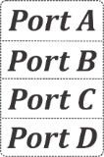

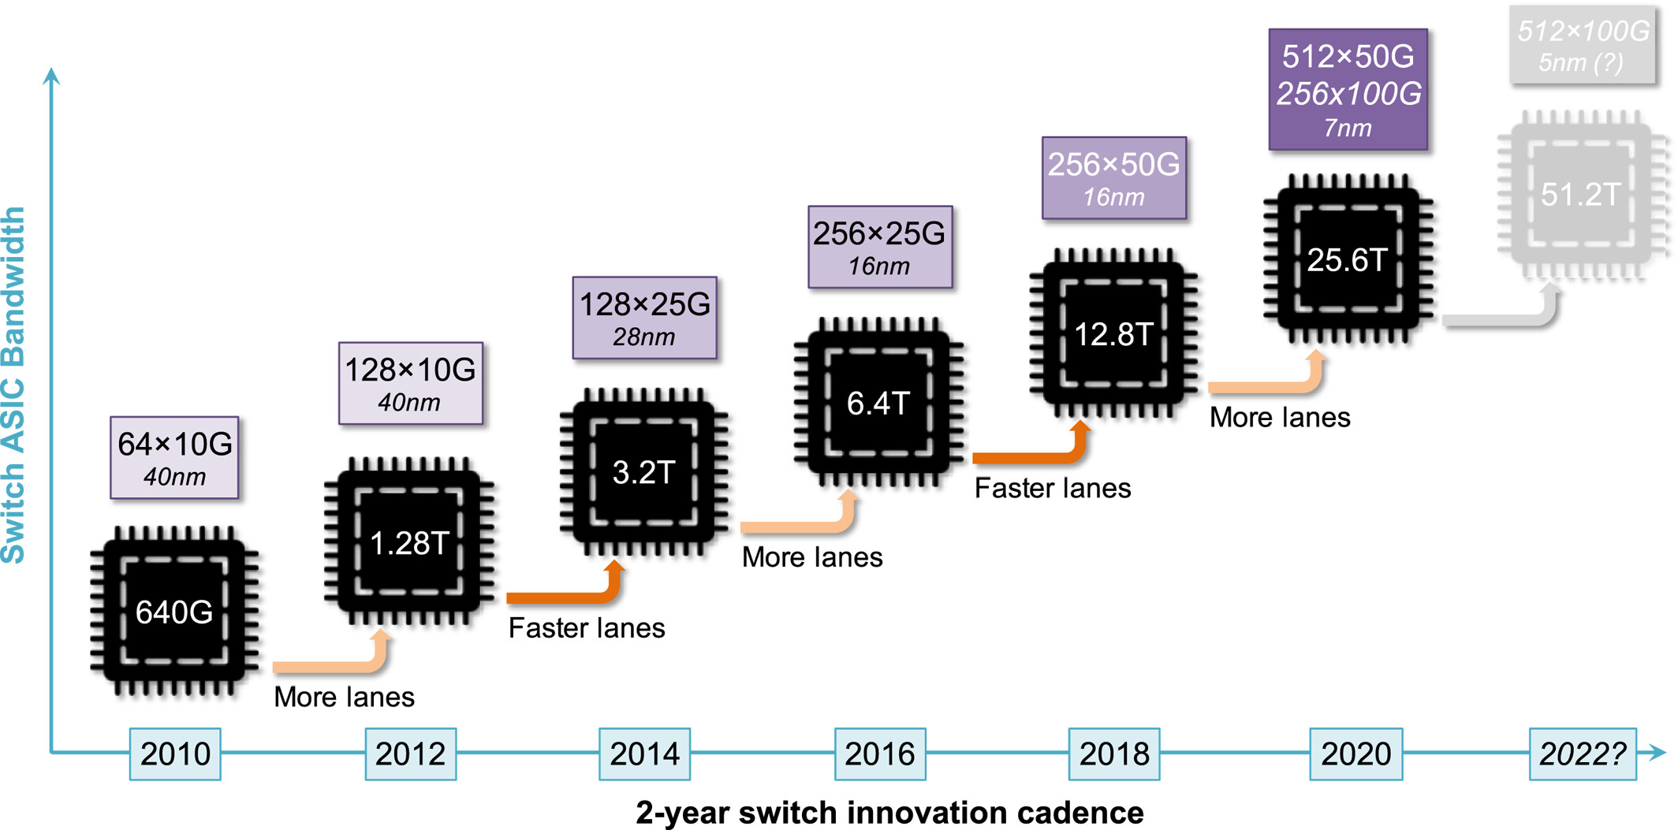
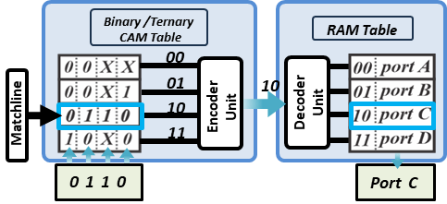
Motivation
ASIC Switching capacity and line-rate growth
Address look-ups and routing
Exponential Growth in Data center traffic
394 Zettabytes of data will be generated by 2028
https://www.statista.com/statistics/871513/worldwide-data-created/
64x1.6T
128x800G
512x200G
3nm
Based on: Co-packaged datacenter optics: Opportunities and challenges
(Revised version)
64x800G
128x400G
5nm
A special hardware memory
51.2T
102.4T
51.2T
Switch ASIC Bandwidth
Current approaches:
NVIDIA Spectrum-X
Broadcom Tomahawk 6
Header processing and forwarding
Data retrieval based on content
Single cycle searching and parallel comparison
2012
2016
2020
2024
2026
Switch capacity line-rates development
Notes:
Increasing bandwidth demands → need to keep up the pace in terms of capacity, bandwidth density and energy efficiency, low latency(optics)
Valiant efforts have been made up until 2026 → 102.4 Tb/s co-packaged optical approaches for switches/ASICs.
- switches: towards efficient routing / switching → CAMs commonly used for: header processing /forwarding
Specific hardware memory engines (CAMs)→ high-rate packet forwarding and searching , key role in today’s routing architectures

Slide 3
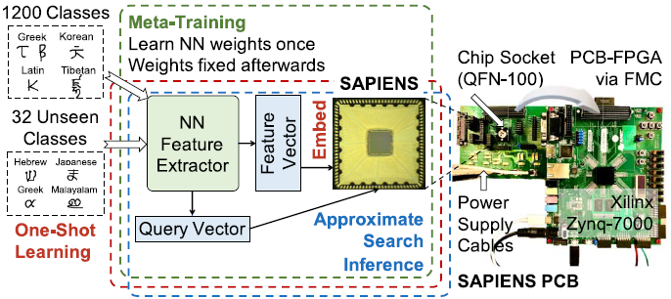
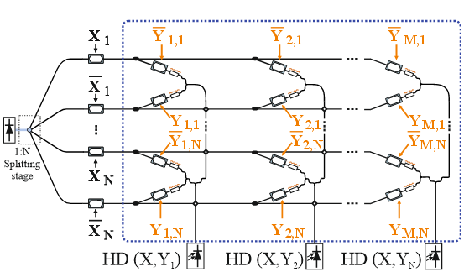
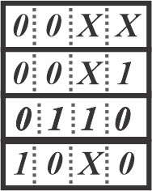
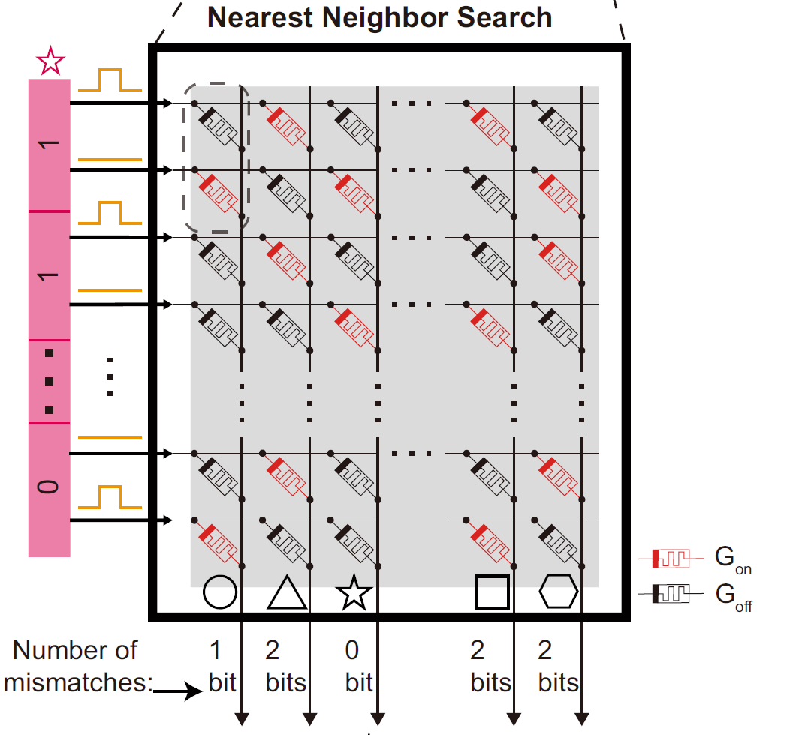
CAM Principle of Operation and Applications
Binary /Ternary
CAM Table
00
10
01
Encoder
Unit
Match
Address
H. Li, et.al., IEEE Trans. On Electron Devices, 2021
10
T. Moschos, et.al., Nat. Commun., 2025
Match
11
R. Mao, et.al., Nat. Commun., 2022
0 1 1 0
Header
Payload
Similarity-based functions (e.g., Hashing, Hamming distance)
In-Memory Computing
Memory Augmented NNs
Incoming Packet Information
Parallel Search with all table entries
Match with identical stored content
Forwarding to Match address
Notes:
Exploit CAMs for, various applications:
packet-switching applications
Comparison operations
In-memory computing → MANNs: by embedding new features into the memory→ inference through similarity-based retrieval features and few-shot learning, etc.

Slide 4
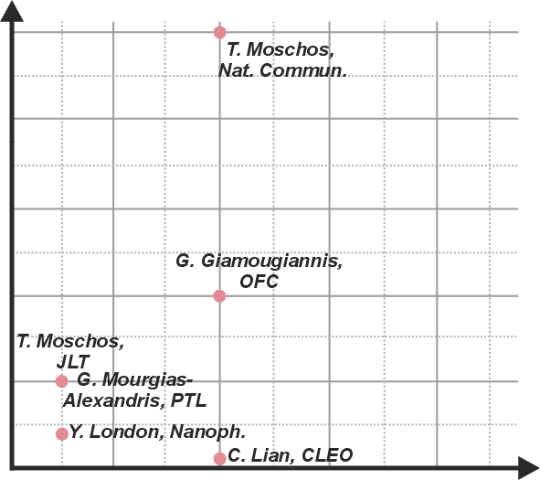
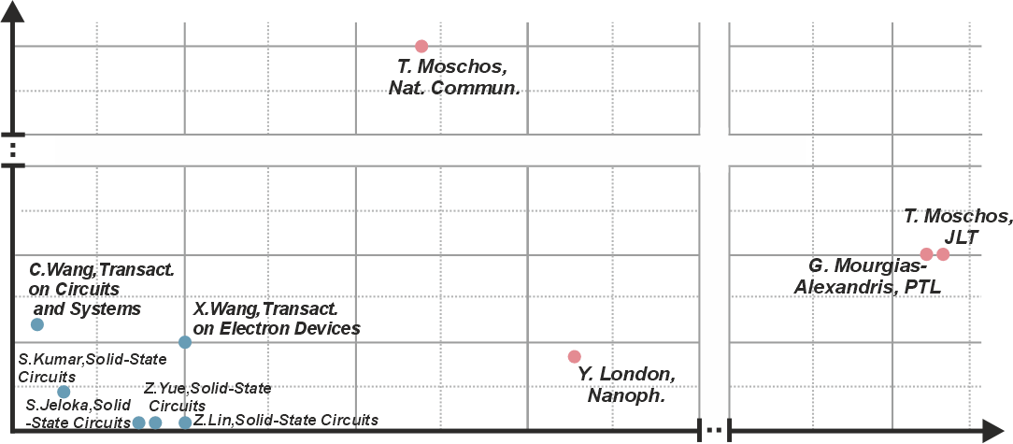
Comparison of Electronic and Photonic CAM Technologies
50
50
Speed Enhancement
40
45
~10× increase
15
Photonics
Operational Speed (GHz)
30
Electronics
Operational Speed (GHz)
10
20
Limited Capacity
(up to 8 bits)
5
Increased Consumption
10
10⁻¹
10⁰
10¹
10²
10³
10⁴
10⁵
4
8
12
16
Energy (fJ/bit)
Capacity (in bits)
Photonic technologies of up to 50 Gb/s data rates
Hard to scale compared to Electronics
High Consumption (pJ/bit) of Optics, compared to Electronics (fJ/bit)
T. Moschos, et. al., “Nonlinear optical vector processing using linear silicon photonic circuits for 50 Gb/s memory and string similarity functions”, Nat. Communications.
Notes:
1st CAM photonic attempts up to pJ/bit consumption (SOAs, etc.)

Slide 5
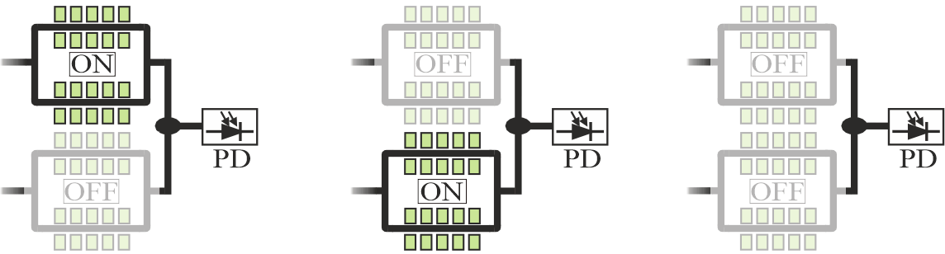
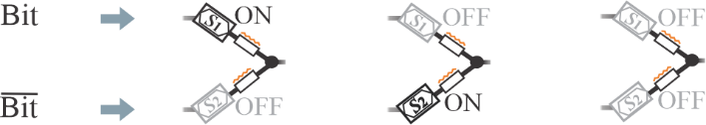
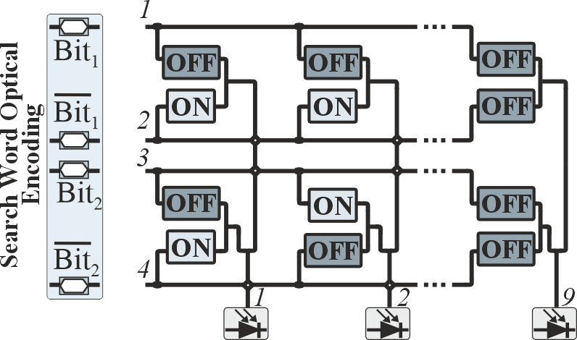
CAM table over a WDM Silicon Photonic Crossbar
S.B. “0”
S.B. “1”
S.B. “X”
λ₁
λ₁
λ₁
1/0
Binary /Ternary
CAM Table
Bit
0
Bit
1
Bit
‘0’ at λ₁
‘0’ at λ₂
‘0’
00
__
__
__
λ₂
0/1
λ₂
Bit
1
Bit
0
λ₂
Bit
01
Encoder
Unit
Match
Address
Search Signals
10
Symmetric
MZI
λ₁
4×9 WDM Ternary CAM Crossbar
Match
11
WDM encoded search bit information
Up to 9 different 2-bit stored words, utilizing a total of 36 MZI cells
λ₂
0 1 1 0
λ₃
λ₄
Notes:
-Realization of CAM through photonic Xbar layout→ principle of operation of CAM cell
Multi-wavelength approach
Parallel Stored content comparison through wavelength assignment

Slide 6
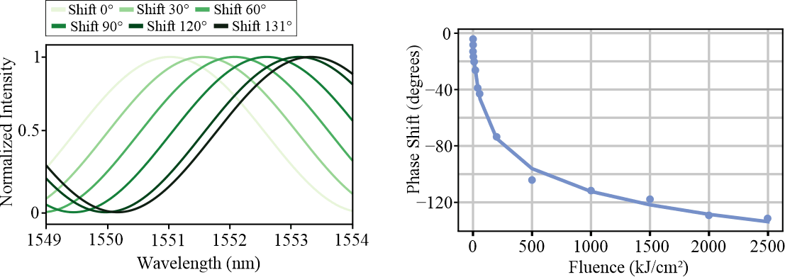
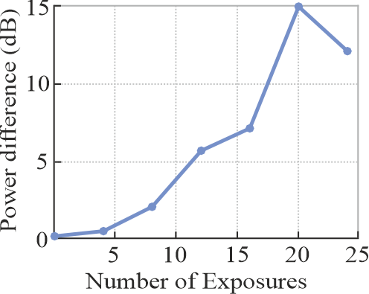
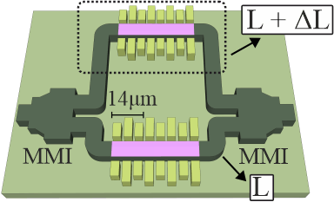
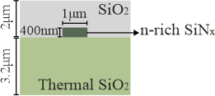
SiPho MZI based on UV exposure
UV Exposure
15 dB
0.5 kJ/cm² of fluence for 4º of phase shift
Permanent change in waveguide’s refractive index
15 dB Achieved Power Difference with 20 Exposures (~1 kJ/cm²)
N-rich SiNx waveguide UV exposure
Notes:
- UV exposure for permanent change in the refractive index of the waveguide material.
Observing the transfer function allows for the definition of fluence and phase change
For a 15 dB power difference (maximum power difference for π phase shift): fluence of 1 kJ/cm2 – 20 exposures (around 9 degrees/exposure)

Slide 7
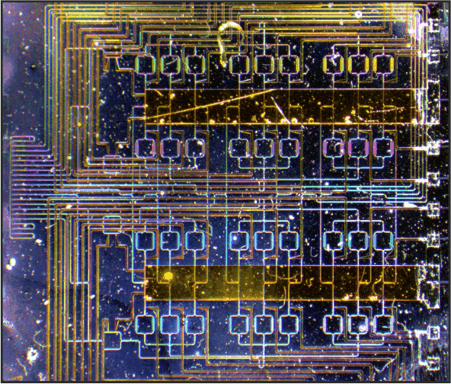
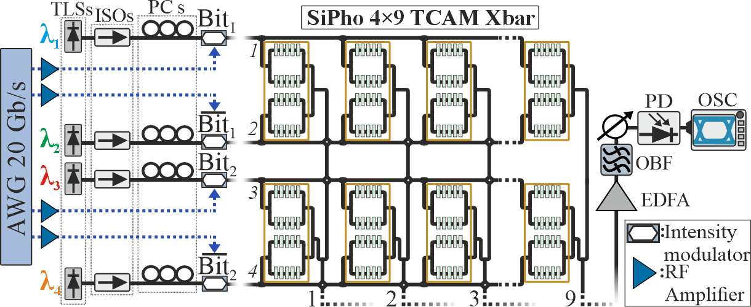
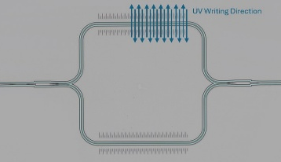
Integrated SiPho 4×9 TCAM
Microscope image
Experimental Setup
6.8mm
λ1: 1556
λ2: 1557
λ3: 1558
λ4: 1559
PRBS9
1
1
0
0
PRBS9
0
0
1
0
8.8mm
4 × 9
PRBS9
1
0
1
0
PRBS9
0
1
0
0
Search Word Encoding:
- Search Bit MZMs: ~ 5.5Vpp
475um
460um
All possible 2-bit binary/ternary stored word combinations
UV Exposable MZI cell

Slide 8
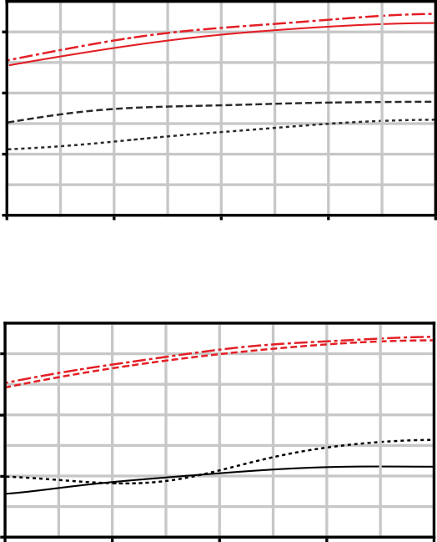
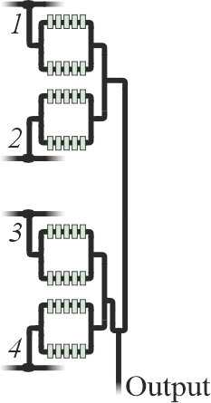
Characterization of Individual MZI memory cells
Output Column 1
Indicative standalone ΜΖΙ cells content
W1,1
-30
W1,2
12 dB
W1,3
-40
Power (dBm)
W1,4
Wi,1
-50
-60
1560
1580
1550
1570
Wi,2
1540
Wavelength(nm)
Output Column 3
W3,1
Wi,3
-30
W3,2
20 dB
W3,3
-40
Power (dBm)
W3,4
Wi,4
-50
Output
High-power “ON” states
Low-power “OFF” states
-60
1580
1560
1550
1570
1540
Wavelength(nm)

Slide 9
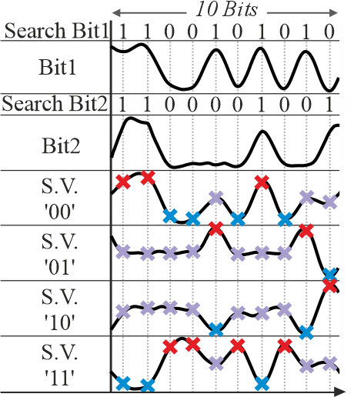
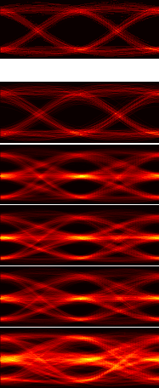
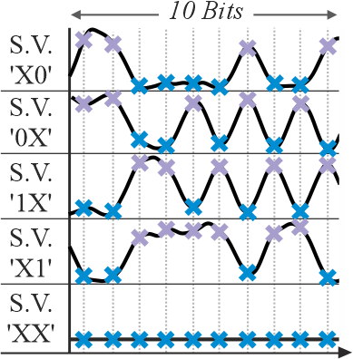
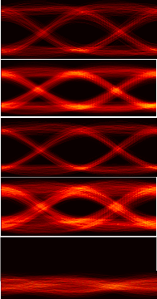
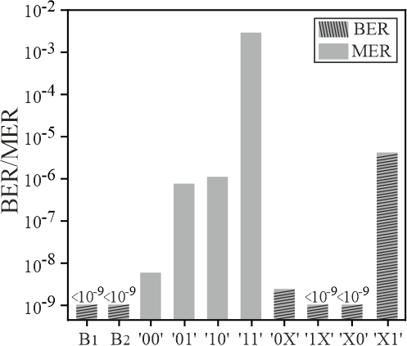
50 Gb/s Parallel Comparison operation
Time Traces
Eye diagrams
Time Traces
Eye diagrams
Error Rates
Time(20 ps/div)
Time(20 ps/div)
x 1-Mismatch
x 2-Mismatch
x Match
Synchronized time traces at 50 Gb/s
Successful 2-bit TCAM comparison operation
Error rate values ranging between 10⁻⁹ and 10⁻³

Slide 10
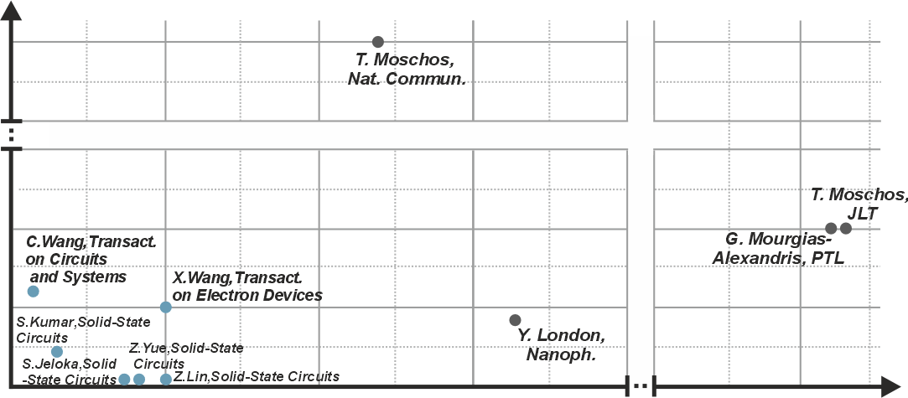
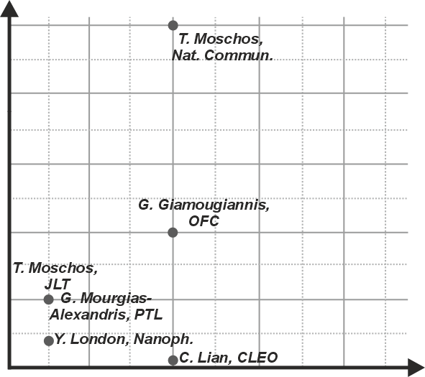
Updating SOTA in CAMs
Zero Electrical Power required
50
50
Current
Work
Current
Work
40
45
15
125% capacity increase
Operational Speed (GHz)
30
Operational Speed (GHz)
10
20
5
10
10⁻¹
10⁰
10¹
10²
10³
10⁴
10⁵
4
8
12
16
18
Energy (fJ/bit)
Capacity (in bits)
More than 100% increase in capacity compared to our previous work
Fully CMOS compatible SiPho WDM 4×9 TCAM Xbar array
Successful 2-bit High-Speed Comparison Operation at 50 Gb/s

Slide 11


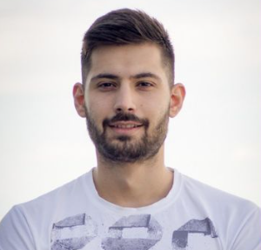
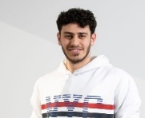
Upcoming Presentations
Session: Photonic AI Computing(W3C)
March 18, 14:00–16:00 PM (PDT), Room 408A
Poster Session II(Th2A)
March 19, 10:30, Petree Hall C
Invited
A. Tsakyridis, et. al., “Hyperdimensional Photonic AI Computing”
A. Prapas, et. al., “Photonic Analog-to-Digital Conversion (ADC) using Photonic Neural Network-assisted Quantization”
S. Kovaios, T. Chrysostomidis, et. al., “Photonic Kolmogorov–Arnold Networks Utilizing SOA-Based SPM Broadening and Filtering Learnable Activations”
O. Asimopoulos, et. al., “Photonic Deep Learning Using In-Situ Optical Backpropagation for Training Photonic Linear Neural Layers”

Slide 12



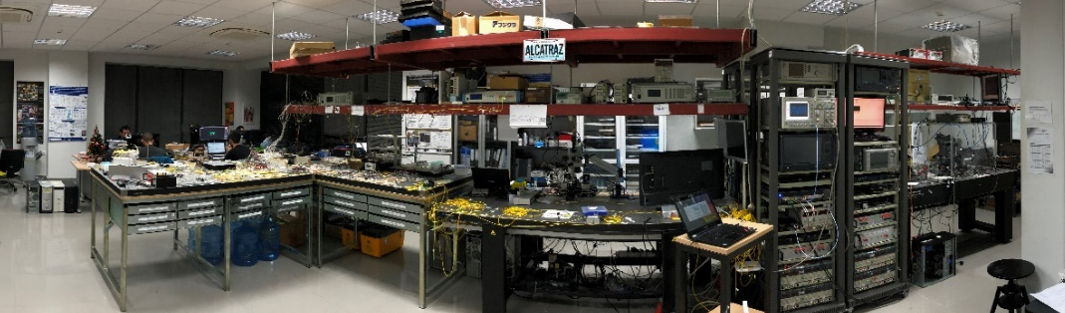
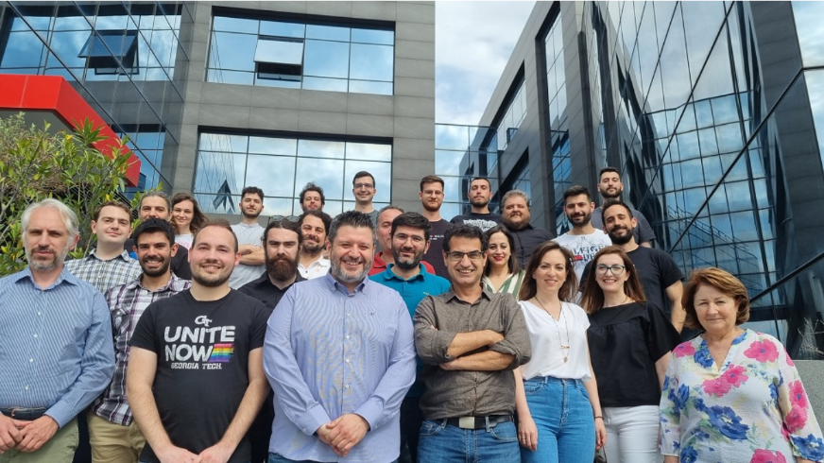
Acknowledgements
EPSRC under grants EP/M013294/1 and EP/W524621/1
OCTAPUS (101070009)
AMBROSIA (101093166)
http://www.octapus-ict.eu/
http://ambrosia-h2022.eu/
Thank you!
Website: http://winphos.web.auth.gr/
Website: https://www.southampton.ac.uk/about/faculties-schools-departments/optoelectronics-research-centre

Slide 13
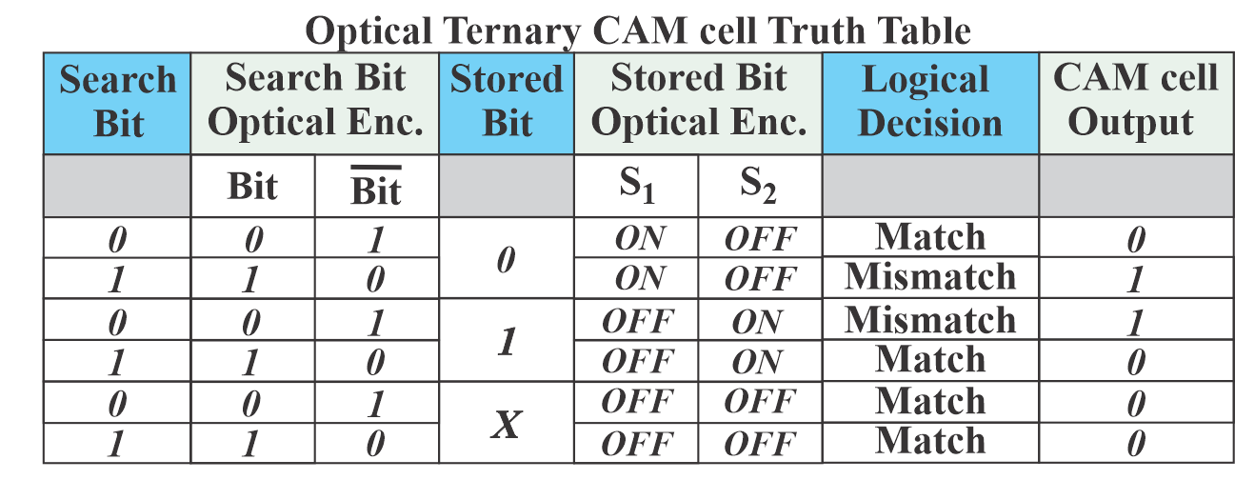
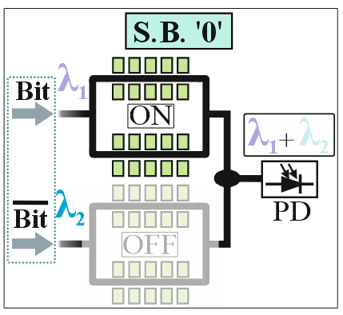
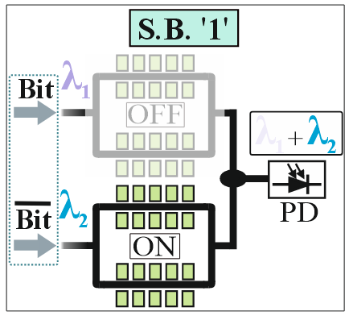
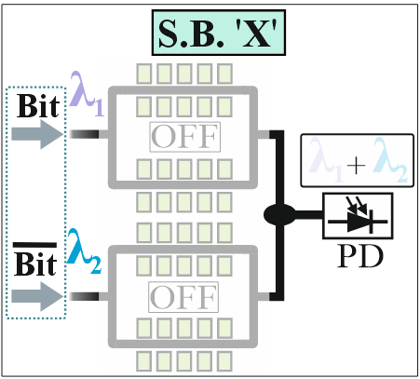
WDM TCAM cell Principle of operation
Truth table for all Search and Stored bit cases and logical output values, for all configured cased of “0”, “1” and “X”
A logical match occurs when only a “0” value is received at the CAM cell output
Notes:
xx

Slide 14
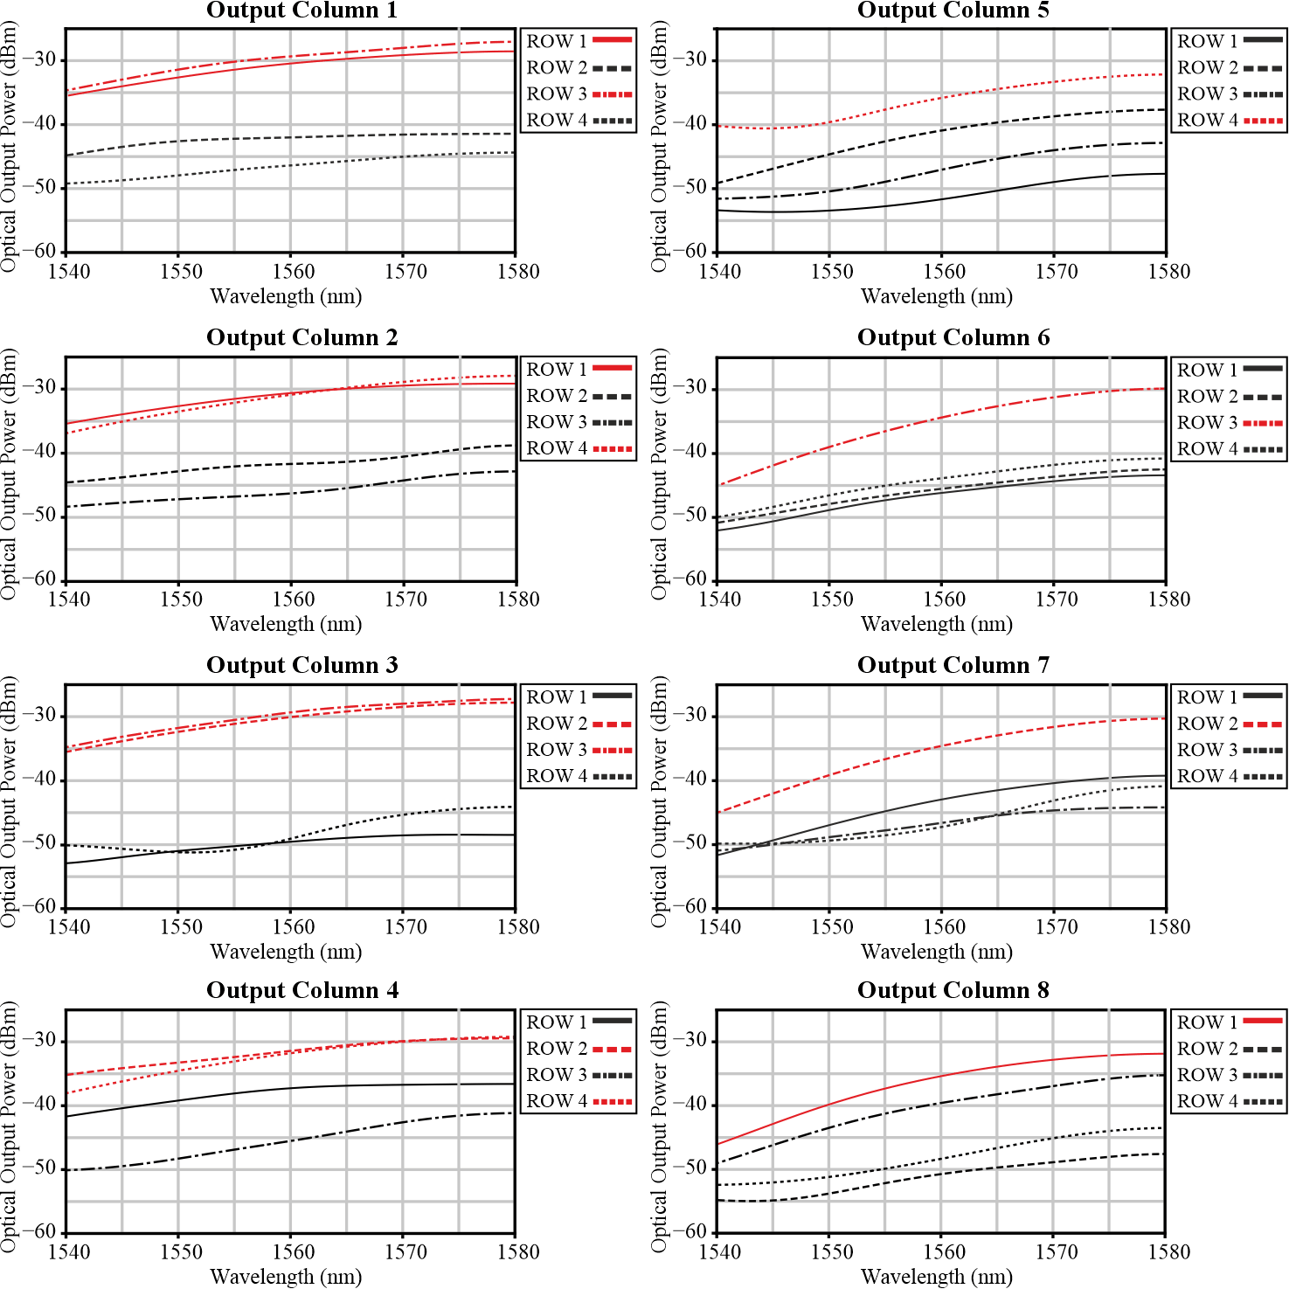
Characterization of the 4×9 TCAM
Optical Spectra
“ON” state
“OFF” state
Optical spectrum measurements for all Xbar Rows/Columns across a 40-nm span (1540-1580 nm)
Discrete differentiation between the high-power “ON” and low-power “OFF” states
Up to 20 dB power differences between the “ON” and “OFF states, for the wavelengths 1556-1559 nm

Slide 15
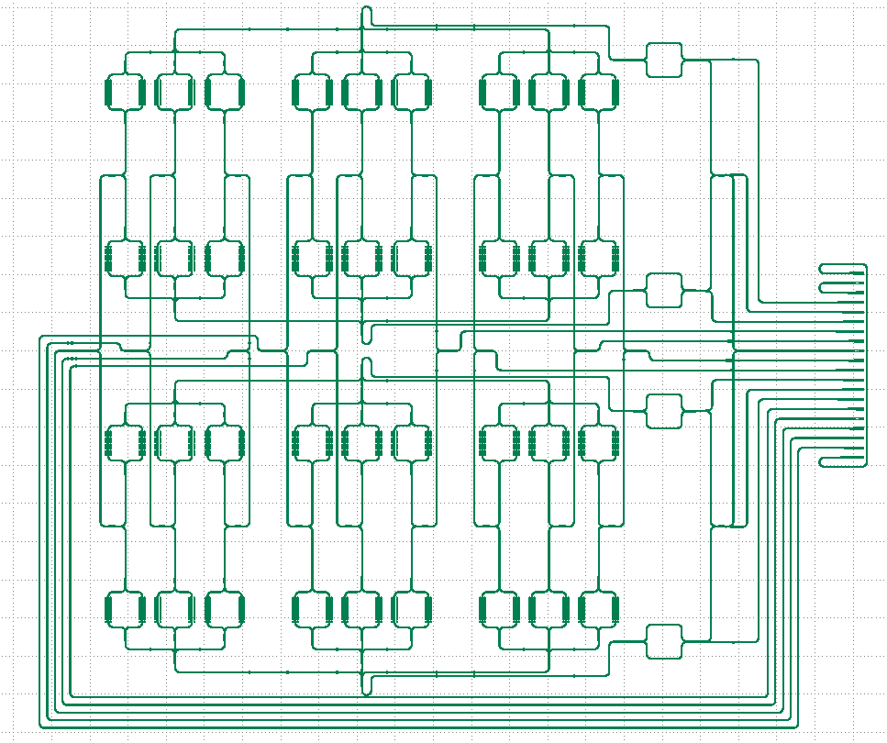
Loss Breakdown
Path Loss breakdown (dB)
Non-Optimal
GDS Mask Layout
Component | Loss (dB)
Two Grating Couplers(In./Out.) | ~ 23
Input 70:30 port | ~ 2
Cascaded 1:3 Splitting (1:9) | ~ 9.5
Static MZI ILs | ~ 1
Cascaded 50:50 Splitting (1:4) | ~ 6
Splitters/Combiners ILs | ~ 2
Crossings ILs (~16/column) | ~1.6
Propagational Losses | 0.5
Input (considering 1 out of 4 λs)
Output
Approximated total path losses: ~ 45 dB
Consideration of on-chip lasers and 99:1 monitors → The total losses can be significantly reduced down to ~20 dB

